Slide 1
SOLID Design Principles
Instructor: Mehroze Khan

Slide 2
SOLID Principles
Good software systems begin with clean code
The SOLID principles tell us how to arrange our functions and data structures into classes, and how those classes should be interconnected
The goal of the principles is the creation of mid-level software structures that:
Tolerate change
Are easy to understand
Are the basis of components that can be used in many software systems
The term “mid-level” refers to the fact that these principles are applied by programmers working at the module level.

Slide 3
SOLID Principles
SRP: Single Responsibility Principle
OCP: Open-Closed Principle
LSP: Liskov Substitution Principle
ISP: Interface Segregation Principle
DIP: Dependency Inversion Principle

Slide 4
OCP-Open Closed Principle
The Open-Closed Principle requires that classes should be open for extension and closed to modification.
Modification means changing the code of an existing class, and extension means adding new functionality.
We should be able to add new functionality without touching the existing code for the class.
This is because whenever we modify the existing code, we are taking the risk of creating potential bugs.
We should avoid touching the tested and reliable (mostly) production code if possible.

Slide 5
OCP-Open Closed Principle
But how are we going to add new functionality without touching the class?
It is usually done with the help of interfaces and abstract classes.

Slide 6
Example-1
Let's say our boss came to us and said that they want invoices to be saved to a database so that we can search them easily.
We think okay, this is easy peasy boss, just give me a second!
We create the database, connect to it, and we add a save method to our InvoicePersistence class

Slide 7
public class InvoicePersistence {
Invoice invoice;
public InvoicePersistence(Invoice invoice) {
this.invoice = invoice;
}
public void saveToFile(String filename) {
// Creates a file with given name and writes the invoice
}
public void saveToDatabase() {
// Saves the invoice to database
}
}

Slide 8
We as the lazy developer for the bookstore, did not design the classes to be easily extendable in the future. So, to add this feature, we have modified the InvoicePersistence class.
If our class design obeyed the Open-Closed principle, we would not need to change this class.
So, as the lazy but clever developer for the bookstore, we see the design problem and decide to refactor the code to obey the principle.

Slide 9
How to Fix?
interface InvoicePersistence {
public void save(Invoice invoice);
}
We change the type of InvoicePersistence to Interface and add a save method. Each persistence class will implement this save method.

Slide 10
How to Fix?
public class DatabasePersistence implements InvoicePersistence {
// Override
public void save(Invoice invoice) {
// Save to DB
}
}

Slide 11
How to Fix?
public class FilePersistence implements InvoicePersistence {
// Override
public void save(Invoice invoice) {
// Save to file
}
}

Slide 12
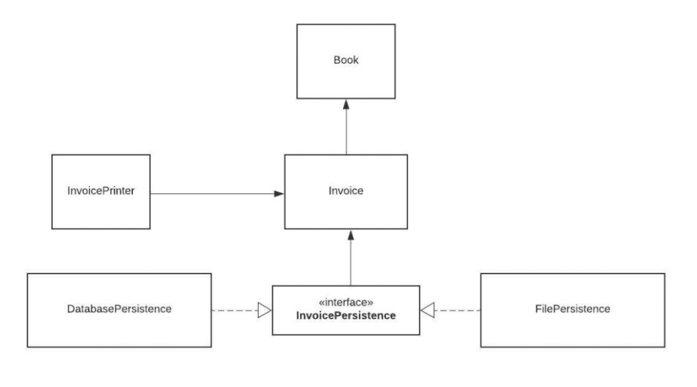
OCP-Open Closed Principle
Our class structure now looks like this:

Slide 13
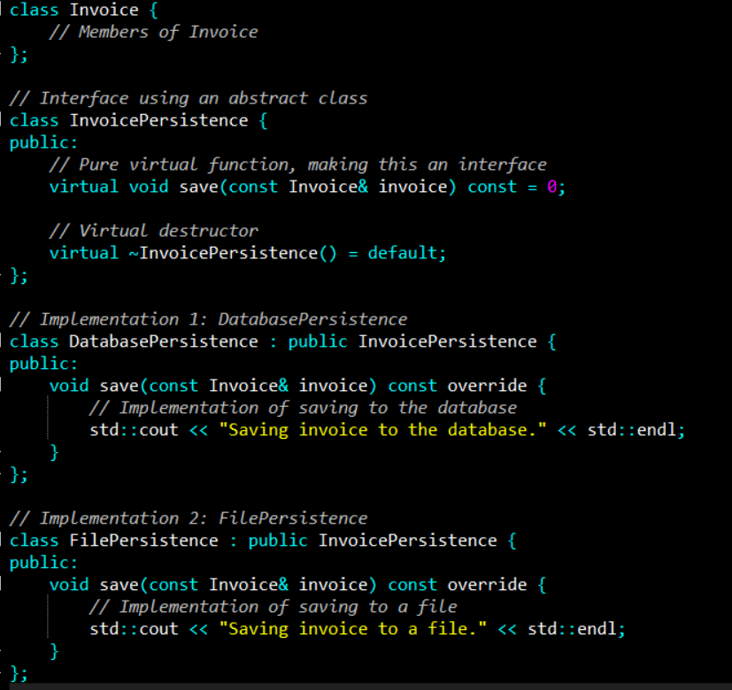

Slide 14
OCP-Open Closed Principle
Now our persistence logic is easily extendable.
If our boss asks us to add another database and have 2 different types of databases like MySQL and MongoDB, we can easily do that.

Slide 15
Example-2
Imagine a program that has two instances of a square and needs a custom component to compare their area. The code would look like the following:
class Square() {
int height;
int area() { return height * height; }
}
public class Example {
public int compareArea(Square a, Square b) {
return a.area() - b.area();
}
}

Slide 16
For this specific use case, the Example class works perfectly well.
It returns zero if the two squares are the same size, a positive number if the first square is larger and a negative number if the first square is smaller.
However, a problem quickly arises when a circle is brought into the mix.

Slide 17
Extension Problem
class Circle {
int r;
int area() { return Math.PI*r*r*;}
}
class Example {
public int compareArea(Square a, Square b) {
return a.area() - b.area();
}
public int compareArea(Circle x, Circle y) {
return x.area() - y.area();
}
}

Slide 18
You can easily imagine the Example class growing larger and larger as more shapes are introduced into the problem domain.
The addition of an interface to our example helps to overcome the violation of the open-closed principle.
An interface allows for infinite future extensions with no need to ever edit the class again.
To fix this example, we first create an interface that both the circle and the square implement

Slide 19
interface Shape {
int area();
}
class Circle implements Shape {
int r;
int area() { return Math.PI*r*r*;}
}
class Square implements Shape {
int height;
int area() { return height * height; }
}

Slide 20
We then create a new class named OpenClosedExample which has a single compareArea method that uses the Shape interface as arguments:
public class OpenClosedExample {
public int compareArea(Shape a, Shape b) {
return a.area() - b.area();
}
}

Slide 21
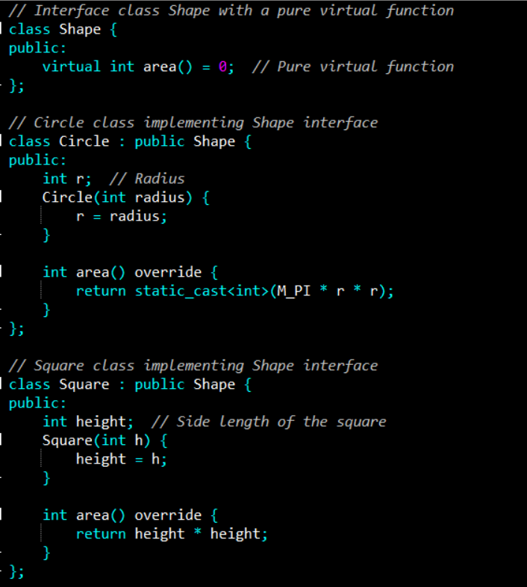

Slide 22
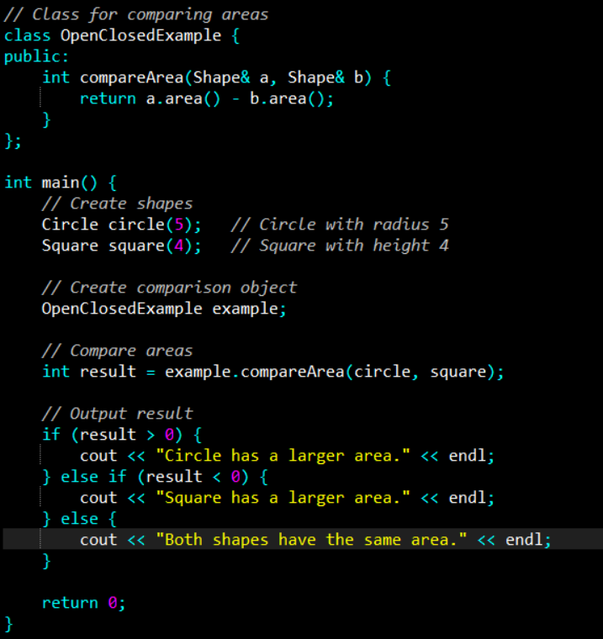

Slide 23
LSP-Liskov Substitution Principle
The Liskov Substitution Principle states that subclasses should be substitutable for their base classes.
This means that, given that class B is a subclass of class A, we should be able to pass an object of class B to any method that expects an object of class A and the method should not give any weird output in that case.
This is the expected behavior, because when we use inheritance, we assume that the child class inherits everything that the superclass has. The child class extends the behavior but never narrows it down.
Therefore, when a class does not obey this principle, it leads to some bugs that are hard to detect.

Slide 24
Example (Bird)
// Base class Bird
class Bird {
public:
virtual void fly() {
cout << "I can fly!" << endl;
}
virtual void eat() {
cout << "I can eat!" << endl;
}
};

Slide 25
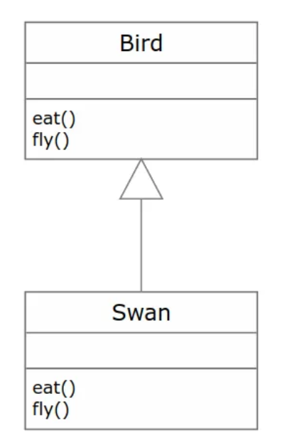
Example (Bird)
// Derived class Swan
class Swan : public Bird {
public:
void fly() override {
cout << "I believe I can fly!" << endl;
}
void eat() override {
cout << "I can eat fish and plants!" << endl;
}
};

Slide 26
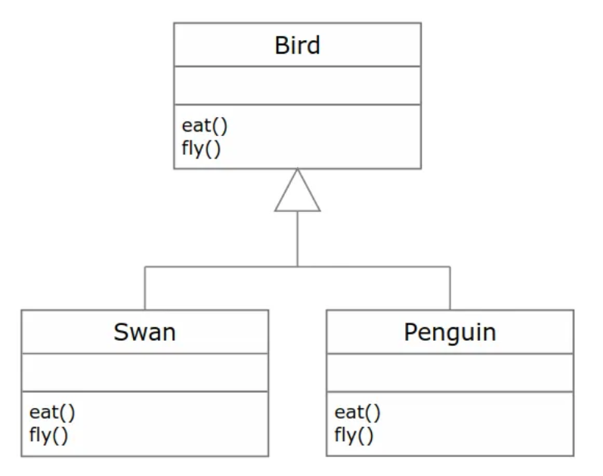
Example (Bird)
// Derived class Penguin
class Penguin : public Bird {
public:
void fly() override {
// Penguins cannot fly, this is not a valid behavior
throw runtime_error("I cannot fly!");
}
void eat() override {
cout << "I can eat fish!" << endl;
}
};

Slide 27
Example (Bird)
// Function to let birds fly
void letBirdsFly(const vector<Bird*>& birds) {
for (const auto& bird : birds) {
bird->fly(); // Call the fly method on each bird
}
}

Slide 28
Example (Bird)
int main() {
vector<Bird*> birds; // Create a vector of Bird pointers
birds.push_back(new Swan());
birds.push_back(new Penguin());
// This will throw an exception due to the Penguin
try {
letBirdsFly(birds);
} catch (const std::exception& e) {
cout << "Error: " << e.what() << endl;
}
}

Slide 29
How Code Violates LSP
Base Class Expectation: The Bird class defines a fly() method that implies that all derived classes (like Swan and Penguin) should be able to "fly." The expectation is that any instance of a Bird can perform the actions defined in the base class without issue.
Penguin Implementation: The Penguin class overrides the fly() method to throw an exception:
void fly() override {
// Penguins cannot fly, this is not a valid behavior
throw std::runtime_error("I cannot fly!");
}

Slide 30
How Code Violates LSP
Penguins do not meet the expectation set by the Bird class. When the program attempts to invoke fly() on a Penguin object, it fails by throwing an exception, which breaks the expected behavior of the system.
This exception disrupts the flow of the program and leads to a crash unless handled with a try-catch block.

Slide 31
Example (Bird) Fix
// Function to let birds fly, skipping Penguins
void letBirdsFly(const vector<Bird*>& birds) {
for (const auto& bird : birds) {
// Attempt to cast to Penguin. If nullptr, it's not a Penguin
if (dynamic_cast<Penguin*>(bird) == nullptr) {
bird->fly();
}
}
}
But this solution is considered a bad practice, and it violates the Open-Closed Principle.
Imagine if we add another three types of birds that cannot fly. The code is going to become a mess.
Notes:
Dynamic Casting: The letBirdsFly function uses dynamic_cast to check if the current Bird is a Penguin. If dynamic_cast returns nullptr, it means the bird is not a Penguin, and we can safely call the fly() method.
dynamic_cast<Penguin*>(bird) attempts to cast the base class pointer (Bird*) to a derived class pointer (Penguin*).This casting checks at runtime if the object pointed to by bird is actually an instance of Penguin.
If the object pointed to by bird is not of type Penguin, dynamic_cast<Penguin*>(bird) will return nullptr. This is because dynamic_cast only works when the actual object is of the type you are casting to, or a type derived from it. If the object is a Penguin, the cast will succeed, and it will return a valid pointer of type Penguin*.

Slide 32
Example (Bird) Fix
// Base class Bird
class Bird {
public:
virtual void eat() {
cout << "I can eat!" << endl;
}
};
// Interface for Flying Birds
class FlyingBird : public Bird {
public:
virtual void fly() = 0;
};
Notes:
Dynamic Casting: The letBirdsFly function uses dynamic_cast to check if the current Bird is a Penguin. If dynamic_cast returns nullptr, it means the bird is not a Penguin, and we can safely call the fly() method.

Slide 33
Example (Bird) Fix
// Derived class Swan
class Swan : public FlyingBird {
public:
void fly() override {
cout << "I believe I can fly!" << endl;
}
void eat() override {
cout << "I can eat fish and plants!" << endl;
}
};
Notes:
Dynamic Casting: The letBirdsFly function uses dynamic_cast to check if the current Bird is a Penguin. If dynamic_cast returns nullptr, it means the bird is not a Penguin, and we can safely call the fly() method.

Slide 34
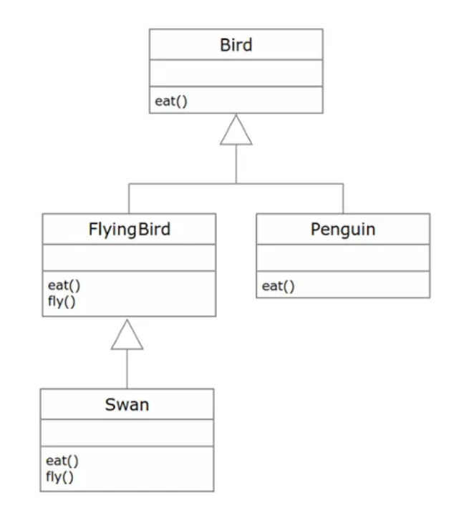
Example (Bird) Fix
// Derived class Penguin
class Penguin : public Bird {
public:
void eat() override {
cout << "I can eat fish!" << endl;
}
};
// Function to let flying birds fly
void letFlyingBirdsFly(const vector<FlyingBird*>& birds) {
for (const auto& bird : birds) {
bird->fly();
}
}
Notes:
Dynamic Casting: The letBirdsFly function uses dynamic_cast to check if the current Bird is a Penguin. If dynamic_cast returns nullptr, it means the bird is not a Penguin, and we can safely call the fly() method.

Slide 35
Example (Bird) Fix
int main() {
vector<FlyingBird*> flyingBirds;
flyingBirds.push_back(new Swan());
// Let all flying birds fly
letFlyingBirdsFly(flyingBirds);
// Create a Penguin (does not need to fly)
Penguin penguin;
penguin.eat(); // This is fine
}
Notes:
Dynamic Casting: The letBirdsFly function uses dynamic_cast to check if the current Bird is a Penguin. If dynamic_cast returns nullptr, it means the bird is not a Penguin, and we can safely call the fly() method.

Slide 36
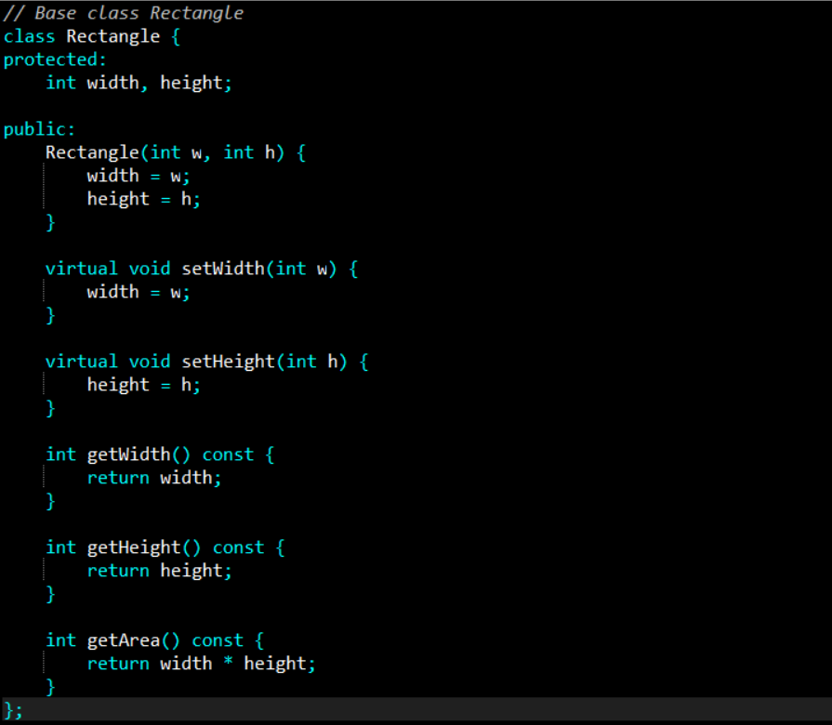
Example (Shape)

Slide 37
Now we decide to create another class for Squares.
As you might know, a square is just a special type of rectangle where the width is equal to the height.

Slide 38
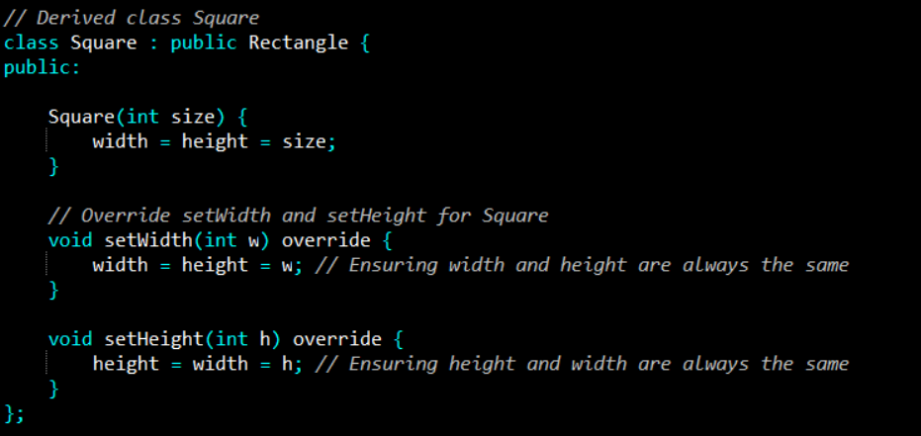
Example (Shape)

Slide 39
Violation
Our Square class extends the Rectangle class. We set height and width to the same value in the constructor, but we do not want any client (someone who uses our class in their code) to change height or width in a way that can violate the square property.
Therefore, we override the setters to set both properties whenever one of them is changed. But by doing that we have just violated the Liskov substitution principle.

Slide 40
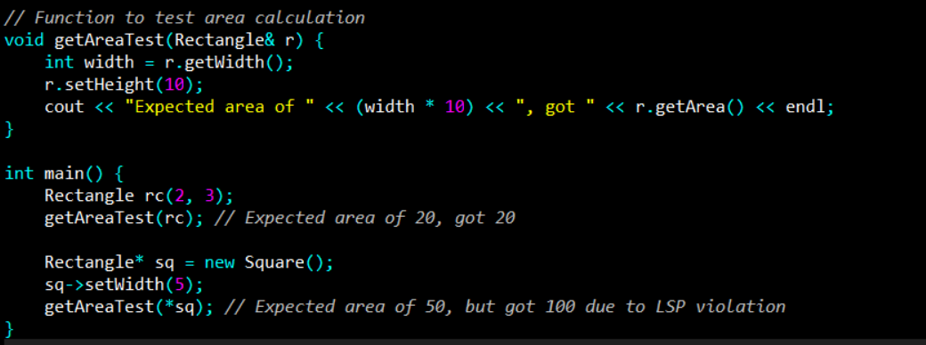
Example (Shape)
Notes:
Expected vs Actual Behavior
For the Rectangle object:
Initial state: width = 2, height = 3.
Inside getAreaTest(): We set the height to 10.
Expected area: width * height = 2 * 10 = 20.
Actual output: Expected area of 20, got 20.
Result: Works as expected.
For the Square object (violating LSP):
Initial state: We set the width (and thus also the height, because it's a Square) to 5.
Inside getAreaTest(): The function sets the height to 10, but for a Square, this also forces the width to 10 because of the overridden methods in Square.
Expected area: We expect the area to be width * height = 5 * 10 = 50 (because getAreaTest() expects the Square to behave like a Rectangle where width and height are independent).
Actual area: Since both width and height are now 10 (because it’s a square), the area is 10 * 10 = 100.

Slide 41
Your team's tester just came up with the testing function getAreaTest and tells you that your getAreaTest function fails to pass the test for square objects.
In the first test, we create a rectangle where the width is 2 and the height is 3 and call getAreaTest. The output is 20 as expected, but things go wrong when we pass in the square.
This is because the call to setHeight function in the test is setting the width as well and results in an unexpected output.

Slide 42
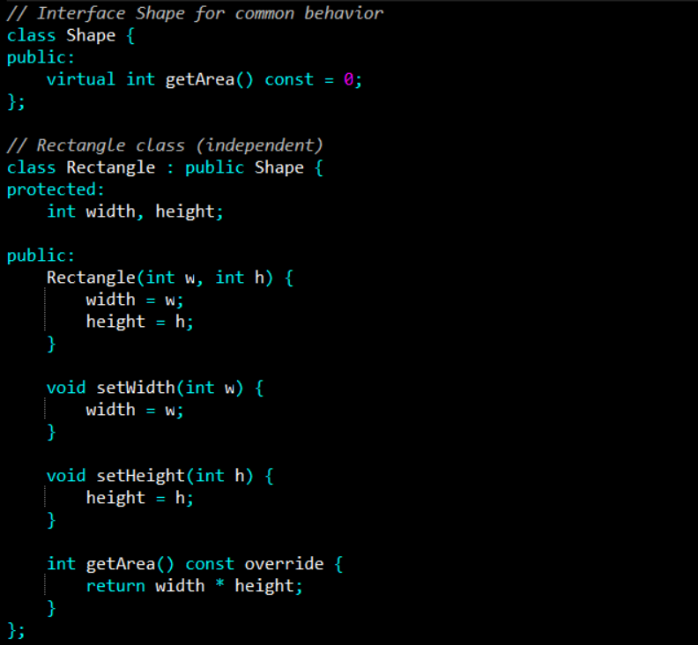
Example (Shape) Fix
Notes:
Expected vs Actual Behavior
For the Rectangle object:
Initial state: width = 2, height = 3.
Inside getAreaTest(): We set the height to 10.
Expected area: width * height = 2 * 10 = 20.
Actual output: Expected area of 20, got 20.
Result: Works as expected.
For the Square object (violating LSP):
Initial state: We set the width (and thus also the height, because it's a Square) to 5.
Inside getAreaTest(): The function sets the height to 10, but for a Square, this also forces the width to 10 because of the overridden methods in Square.
Expected area: We expect the area to be width * height = 5 * 10 = 50 (because getAreaTest() expects the Square to behave like a Rectangle where width and height are independent).
Actual area: Since both width and height are now 10 (because it’s a square), the area is 10 * 10 = 100.

Slide 43
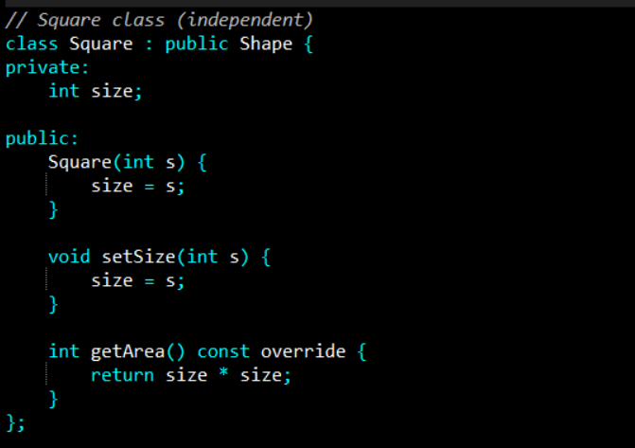
Example (Shape) Fix
Notes:
Expected vs Actual Behavior
For the Rectangle object:
Initial state: width = 2, height = 3.
Inside getAreaTest(): We set the height to 10.
Expected area: width * height = 2 * 10 = 20.
Actual output: Expected area of 20, got 20.
Result: Works as expected.
For the Square object (violating LSP):
Initial state: We set the width (and thus also the height, because it's a Square) to 5.
Inside getAreaTest(): The function sets the height to 10, but for a Square, this also forces the width to 10 because of the overridden methods in Square.
Expected area: We expect the area to be width * height = 5 * 10 = 50 (because getAreaTest() expects the Square to behave like a Rectangle where width and height are independent).
Actual area: Since both width and height are now 10 (because it’s a square), the area is 10 * 10 = 100.

Slide 44
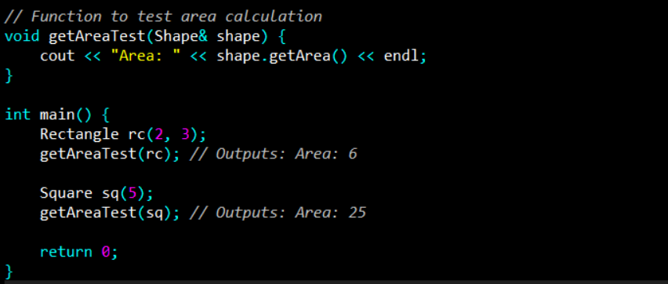
Example (Shape) Fix
Notes:
Expected vs Actual Behavior
For the Rectangle object:
Initial state: width = 2, height = 3.
Inside getAreaTest(): We set the height to 10.
Expected area: width * height = 2 * 10 = 20.
Actual output: Expected area of 20, got 20.
Result: Works as expected.
For the Square object (violating LSP):
Initial state: We set the width (and thus also the height, because it's a Square) to 5.
Inside getAreaTest(): The function sets the height to 10, but for a Square, this also forces the width to 10 because of the overridden methods in Square.
Expected area: We expect the area to be width * height = 5 * 10 = 50 (because getAreaTest() expects the Square to behave like a Rectangle where width and height are independent).
Actual area: Since both width and height are now 10 (because it’s a square), the area is 10 * 10 = 100.

Slide 45
References
Clean Architecture: A Craftsman's Guide to Software Structure and Design, 1st Edition, Robert C. Martin, Pearson, 2017.

